Slide 1
Azure Apps & Infrastructure – SMB Sales Plays
WE SMB Cloud Champion Partner Version
For the latest update please visit your Cloud Champion Portal

Slide 2
PLAY-IN-A-BOX NAVIGATION
Azure Apps & Infrastructure
SMB – PARTNER FACING
Overview
Definitions
PiB Content Overview
Play-in-the-Box
Windows Server on Azure
WE SMB Cloud Champion Partner Version
PARTNER
Play-in-a-box
Your one-stop shop to land Azure Sales Plays

Slide 3
Solution Areas | Plays | Sales Motions: Definitions
PLAY-IN-A-BOX NAVIGATION
Overview
Definitions
PiB Content Overview
SOLUTION
AREAS
| App & Infra | Data & AI | 2 solution pillars designed to help our customers achieve their Digital Transformation outcomes.
Play-in-the-Box
1
Windows Server on Azure
SOLUTION SALES PLAYS
A Play is a defined, programmatic approach to monetize a prioritized capability of a solution area.
Example: SAP on Azure is a specific capability of Applications & Infrastructure solution area and a targeted approach to monetize this capability, will be defined through a play.
2
SALES MOTIONS
Targeted set of activities that help operationalize the play by generating demand, accelerating pipe and/or driving consumption for it.
Example: Targeting Upper Midsized Business accounts using Azure Cloud Migration Assessment will be one of the sales motions to land a WS / SQL Server on Azure play.
3
Notes:
Cloud Migration Services: $7B
Azure market: $500B

Slide 4
The 6-point Execution Agenda for Landing the Partner Sales Play-in-a-Box
PLAY-IN-A-BOX NAVIGATION
Overview
Definitions
PiB Content Overview
Play-in-the-Box
Windows Server
Value Proposition
Target Scenarios
Incentive/Offer
1
2
3
Sales & Marketing
Assets
Probing Questions
Enablement
4
5
6

Slide 5
Go back to TOC
2. Windows Server on Azure

Slide 6
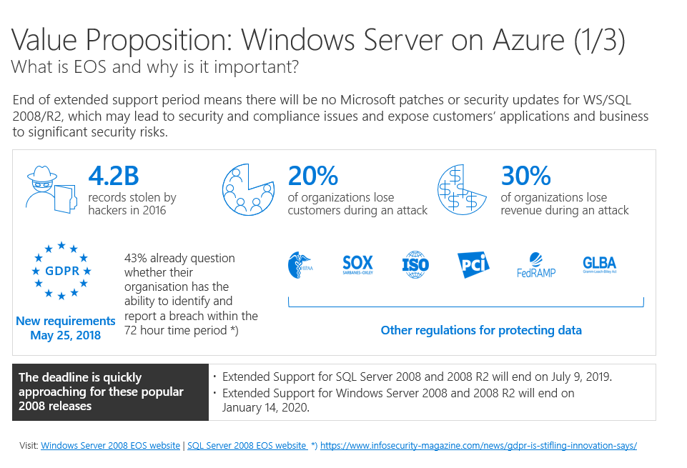
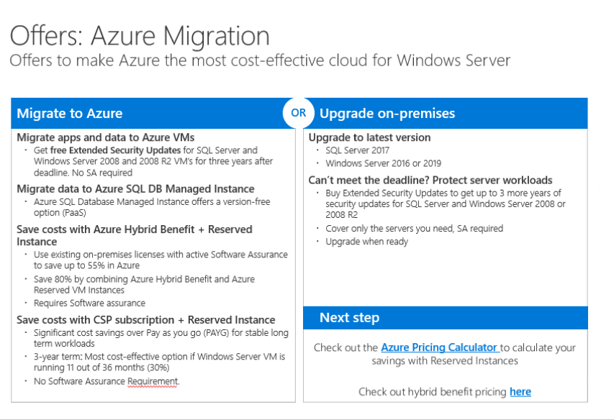
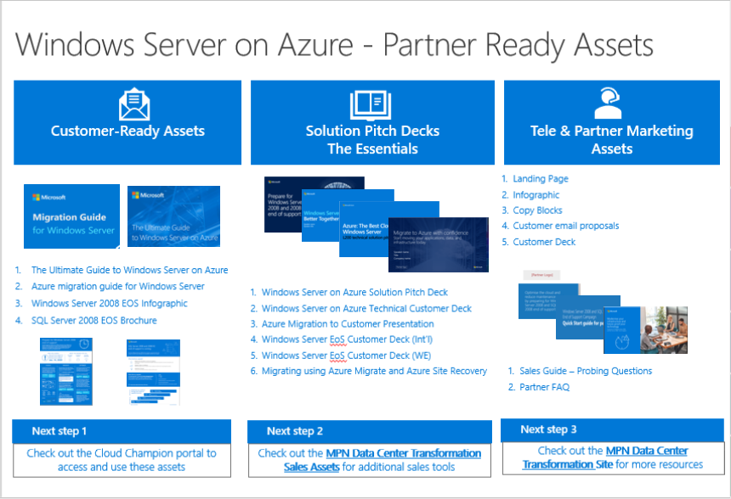
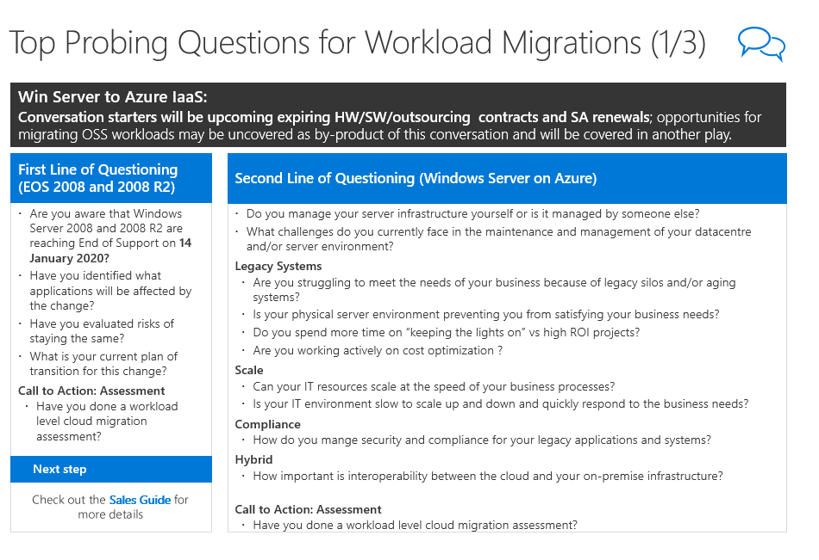
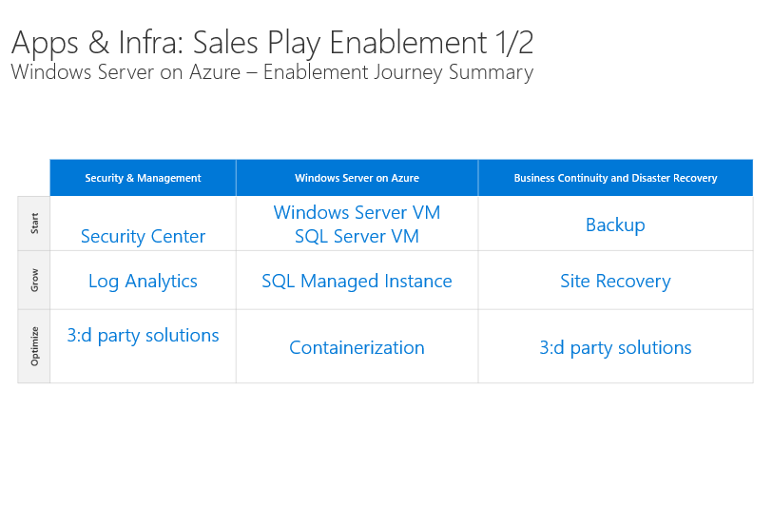
Windows Server on Azure PiB
PLAY-IN-A-BOX NAVIGATION
Overview
Definitions
PiB Content Overview
Play-in-the-Box
Value Proposition
Target Scenarios
Incentive/Offer
1
2
3
Windows Server on Azure
Aging systems
Agreement renewals (SW, HW, Sourcing) ​
Digital transformation agenda
BCDR / Storage in Azure
No Azure
1. Value Proposition
Page 1 of 3
Page 2 of 3
Page 3 of 3
2. Target Scenarios
3. Offers/Incentives/CTAs
4. Sales & Marketing Assets
5. Probing Questions
6. Enablement
Click on image for more details
Click on image for more details
Sales & Marketing Assets
Probing questions
Enablement
4
5
6
Click on image for more details
Click on image for more details
Click on image for more details

Slide 7
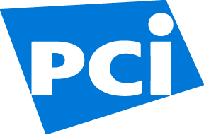
Value Proposition: Windows Server on Azure (1/3) What is EOS and why is it important?
PLAY-IN-A-BOX NAVIGATION
Overview
Definitions
PiB Content Overview
End of extended support period means there will be no Microsoft patches or security updates for WS/SQL 2008/R2, which may lead to security and compliance issues and expose customers’ applications and business to significant security risks.
Play-in-the-Box
Windows Server on Azure
1. Value Proposition
Page 1 of 3
4.2B records stolen by hackers in 2016
20% of organizations lose customers during an attack
30% of organizations lose revenue during an attack
Page 2 of 3
Page 3 of 3
2. Target Scenarios
3. Offers/Incentives/CTAs
4. Sales & Marketing Assets
5. Probing Questions
6. Enablement
43% already question whether their organisation has the ability to identify and report a breach within the 72 hour time period *)
GDPR
New requirements May 25, 2018
Other regulations for protecting data
The deadline is quickly approaching for these popular 2008 releases
Extended Support for SQL Server 2008 and 2008 R2 will end on July 9, 2019.
Extended Support for Windows Server 2008 and 2008 R2 will end on January 14, 2020.
Visit: Windows Server 2008 EOS website | SQL Server 2008 EOS website *) https://www.infosecurity-magazine.com/news/gdpr-is-stifling-innovation-says/

Slide 8
Value Proposition: Windows Server on Azure 2/3
PLAY-IN-A-BOX NAVIGATION
Overview
Definitions
Opportunities and Challenges by numbers
Migration to Azure can address critical issues
Better together
Azure and Windows Server
PiB Content Overview
Play-in-the-Box
Software will be the largest category of SMB IT spending in 2019¹
Customers can spend up to four times the cost of their software license per year to own and manage their applications.²
56% of business leaders say their digital improvements have already improved profit. ³
48% of businesses say new technology will influence growth over the next three years.⁴
Unique powerful Hybrid Security
Combine Windows Server built-in security with Azure, the most compliant cloud.
Use Azure Security Center for monitoring and threat protection across on-premises & cloud.
Most cost-effective home for Windows Server
Deploy in minutes. Scale up and down when you need. Pay only for what you use.
Save costs with Reserved Instances (RI) and existing licenses for stable workloads
Best Hybrid Cloud Experience
Extend to Azure for unique hybrid infrastructure scenarios with Windows Admin Center, Active Directory, cloud storage, and more.
Run and modernize Windows server apps on virtual machines, SQL MI or containers in Azure
Go to cloud using your Microsoft expertise and familiar tools. Support from a single vendor.
Security and Compliance
Avoid disruptions, loss of customers and brand reputation
Protect your organisation, and future-proof your technology
Windows Server on Azure
1. Value Proposition
Page 1 of 3
Page 2 of 3
Page 3 of 3
2. Target Scenarios
3. Offers/Incentives/CTAs
4. Sales & Marketing Assets
5. Probing Questions
Optimizing Costs
Avoid increasing maintenance costs for aging infrastructure
Improve ROI by converting CAPEX to flexible OPEX
6. Enablement
Staying Competitive
Embrace Digital transformation
Improve Customer Service
Next step =>
Check out the Ultimate Guide to Windows Server on Azure
Source: 1) https://www.channel-impact.com/report-smb-spending-to-exceed-600-billion-this-year/ 2) The End of Software – Gartner 3) https://enterprisersproject.com/what-is-digital-transformation 4) https://www.forbes.com/sites/briansutter/2017/10/21/the-state-of-small-business-marketing/#7936764e200e

Slide 9
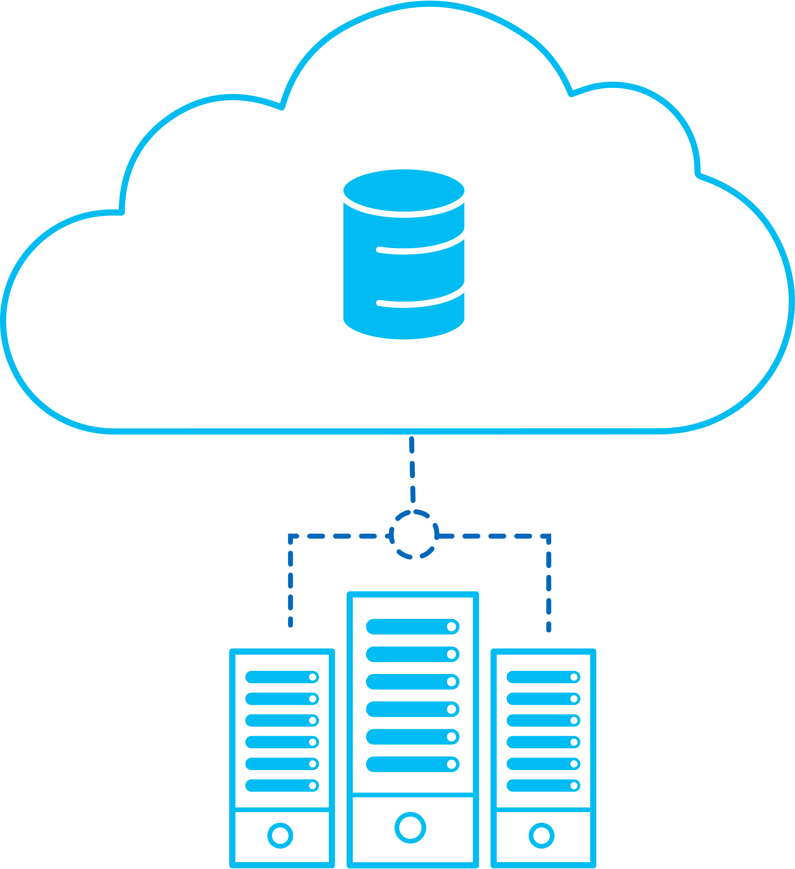
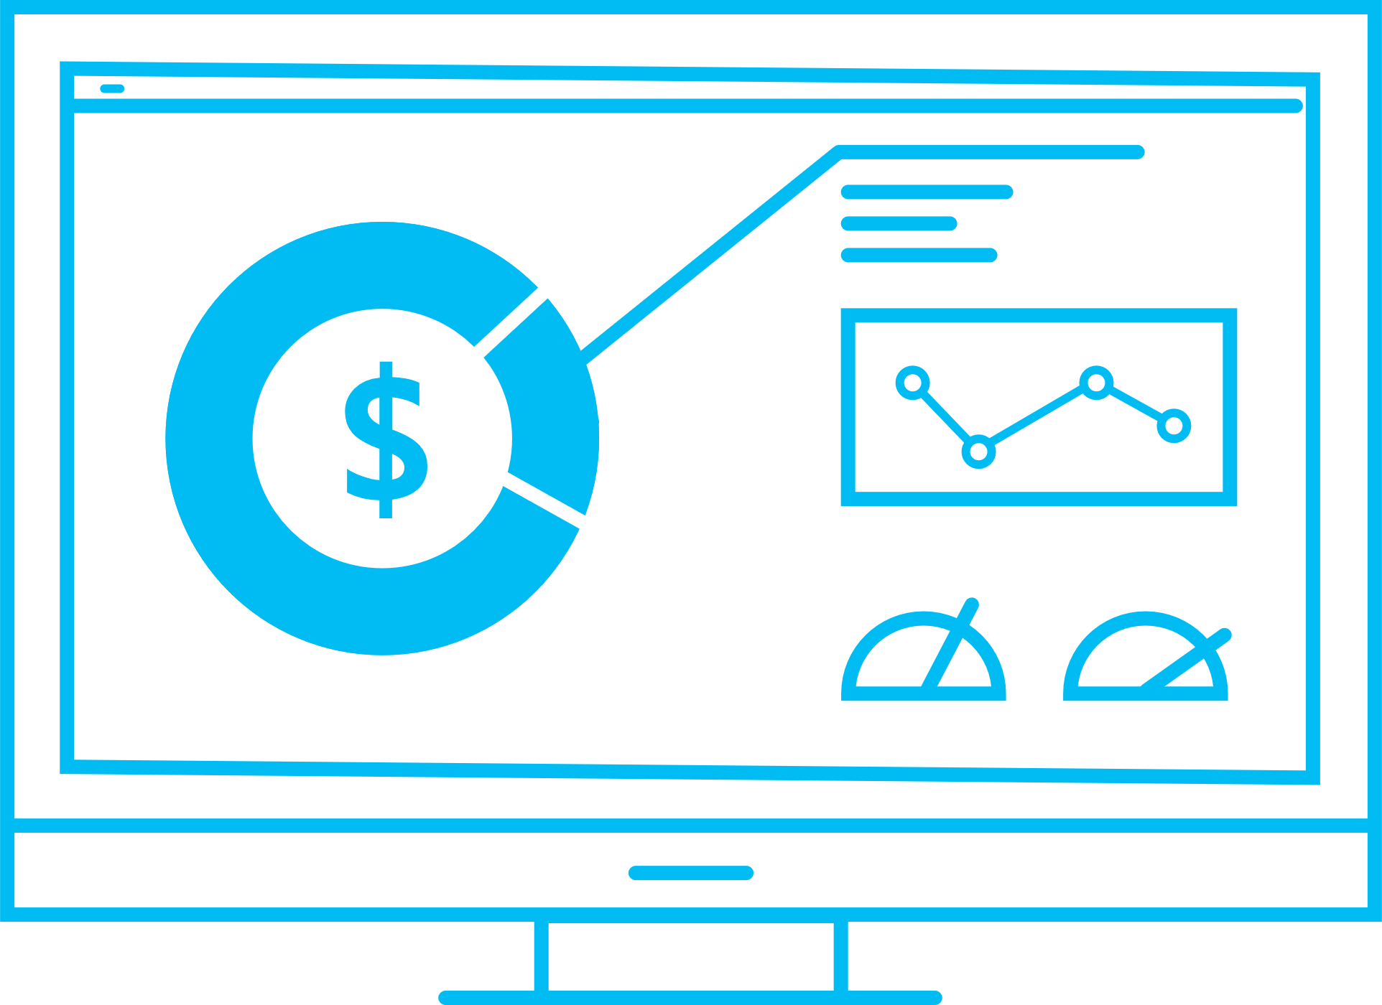
Value Proposition: Migrate with confidence (3/3)
PLAY-IN-A-BOX NAVIGATION
Overview
Definitions
PiB Content Overview
Play-in-the-Box
Migration Process
Benefits
Windows Server on Azure
Azure migration solutions provide a proven framework and tools for migrating your first workloads—including a roadmap for discovery, migration, and continual optimization
Strong ecosystem of ISV and SI partners to expand discovery and migration tool offerings
Reward offers for greater ROI and lower TCO
Check out the Azure Migration Center for tools, guidance, & experts
Azure.com/migration
1. Value Proposition
Discover
Migrate
Optimize
Page 1 of 3
Page 2 of 3
Page 3 of 3
2. Target Scenarios
Business viability study
Technical viability study
Transition planning
VM migration
Ongoing management
Ongoing Azure VM rightsizing
App and data
transformation
3. Offers/Incentives/CTAs
4. Sales & Marketing Assets
Workload/app/database migration
5. Probing Questions
6. Enablement
Next step

Slide 10
Offers: Azure Migration Offers to make Azure the most cost-effective cloud for Windows Server
PLAY-IN-A-BOX NAVIGATION
Overview
Definitions
PiB Content Overview
Play-in-the-Box
Migrate to Azure
OR
Upgrade on-premises
Windows Server on Azure
Migrate apps and data to Azure VMs
Get free Extended Security Updates for SQL Server and Windows Server 2008 and 2008 R2 VM’s for three years after deadline. No SA required
Migrate data to Azure SQL DB Managed Instance
Azure SQL Database Managed Instance offers a version-free option (PaaS)
Save costs with Azure Hybrid Benefit + Reserved Instance
Use existing on-premises licenses with active Software Assurance to save up to 55% in Azure
Save 80% by combining Azure Hybrid Benefit and Azure Reserved VM Instances
Requires Software assurance
Save costs with CSP subscription + Reserved Instance
Significant cost savings over Pay as you go (PAYG) for stable long term workloads
3-year term: Most cost-effective option if Windows Server VM is running 11 out of 36 months (30%)
No Software Assurance Requirement.
Upgrade to latest version
SQL Server 2017
Windows Server 2016 or 2019
Can’t meet the deadline? Protect server workloads
Buy Extended Security Updates to get up to 3 more years of security updates for SQL Server and Windows Server 2008 or 2008 R2
Cover only the servers you need, SA required
Upgrade when ready
1. Value Proposition
Page 1 of 3
Page 2 of 3
Page 3 of 3
2. Target Scenarios
3. Offers/Incentives/CTAs
4. Sales & Marketing Assets
5. Probing Questions
6. Enablement
Next step
Check out the Azure Pricing Calculator to calculate your savings with Reserved Instances
Check out hybrid benefit pricing here

Slide 11
Windows Server | Incentives/Programs/Offers/CTAs
PLAY-IN-A-BOX NAVIGATION
Overview
Definitions
PiB Content Overview
Program
Description
Activity
Play-in-the-Box
Microsoft |  | CSP Incentives |  | Azure Consumed Revenue Customer Adds |  | Payout
 |  | CSP Subscriptions |  | Windows Server SQL Server |  | License
 |  | Hybrid Use Benefit |  | Use your license to benefit from a lower price on Windows Server VMs |  | Offer: Lower priced SKU
 |  | Reserved Instances |  | Windows Server Virtual Machine Instances SQL Server compute (not the SQL server license) Cosmos DB |  | Offer: Lower Priced SKU
 |  | Free Security Updates |  |  |  | Offer
 |  | Go To Market Support |  | Marketing Services to generate demand |  | Various co-funded
 |  | WS Hero Offer |  | CSP subscriptions + Reserved Instances (RI) Link to Partner Center here |  | Offer
 |  | WIP: Proposal/s |  | WIP: Pre defined proposals for Windows Server on Azure |  | Predefined proposals
Cloud Solution Provider (suggested) |  | Migration Plan |  | The plan for Assessment, Migration and Optimization |  | Consultancy service
 |  | Managed Service |  | Managed Windows Server on Azure Managed SQL Server on Azure Optimization Services |  | Packaged Offer/s with monthly fees
 |  | Assessment |  | Cloud migration assessment services – Technical Viability, Business Viability, Migration Planning |  | Report
 |  | PoC |  | Proof of Concept on customer subscription |  | Test & Validation
Indirect Provider |  | TBA |  | Refer to your Indirect provider |  | Various
Other |  | Linux on Azure |  | Refer to Linux on Azure Sales Play |  | Sales Motion
Windows Server on Azure
1. Value Proposition
Page 1 of 3
Page 2 of 3
Page 3 of 3
2. Target Scenarios
3. Offers/Incentives/CTAs
4. Sales & Marketing Assets
5. Probing Questions
6. Enablement

Slide 12
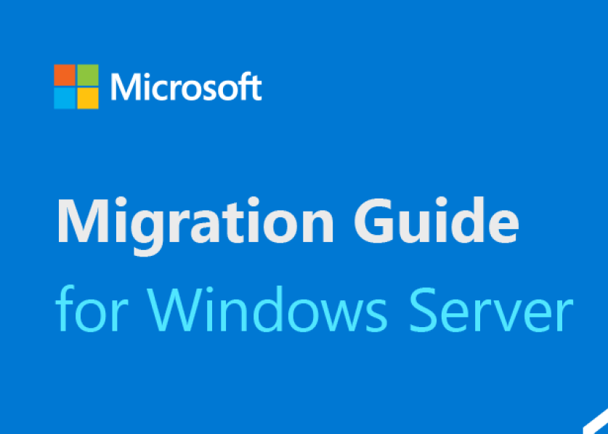
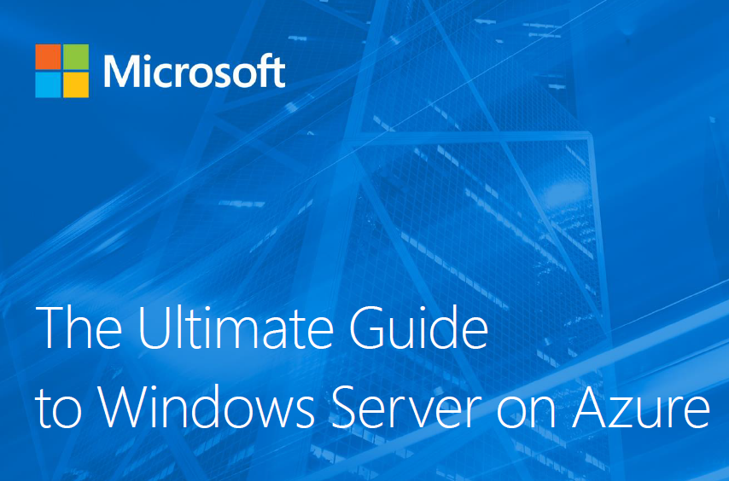
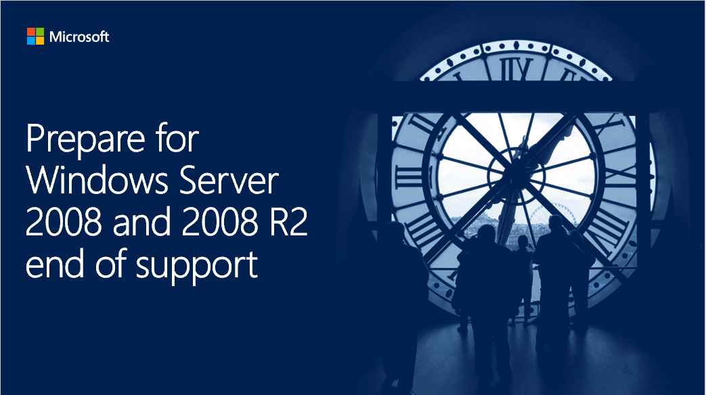
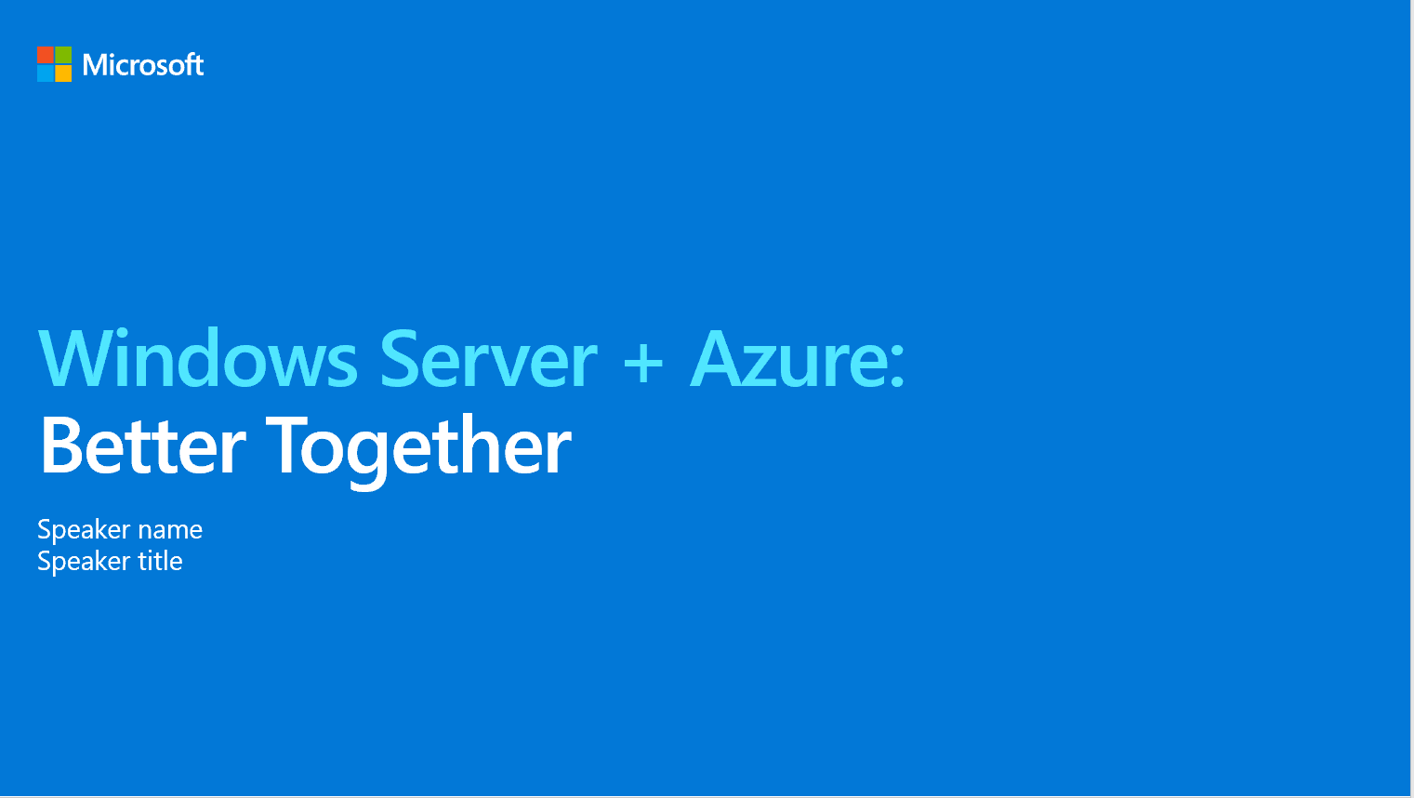
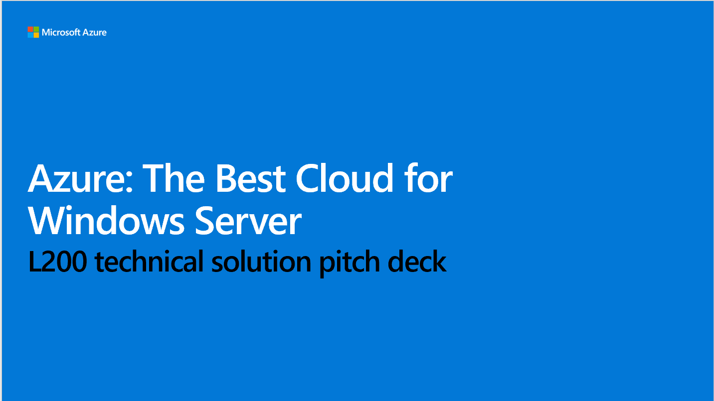
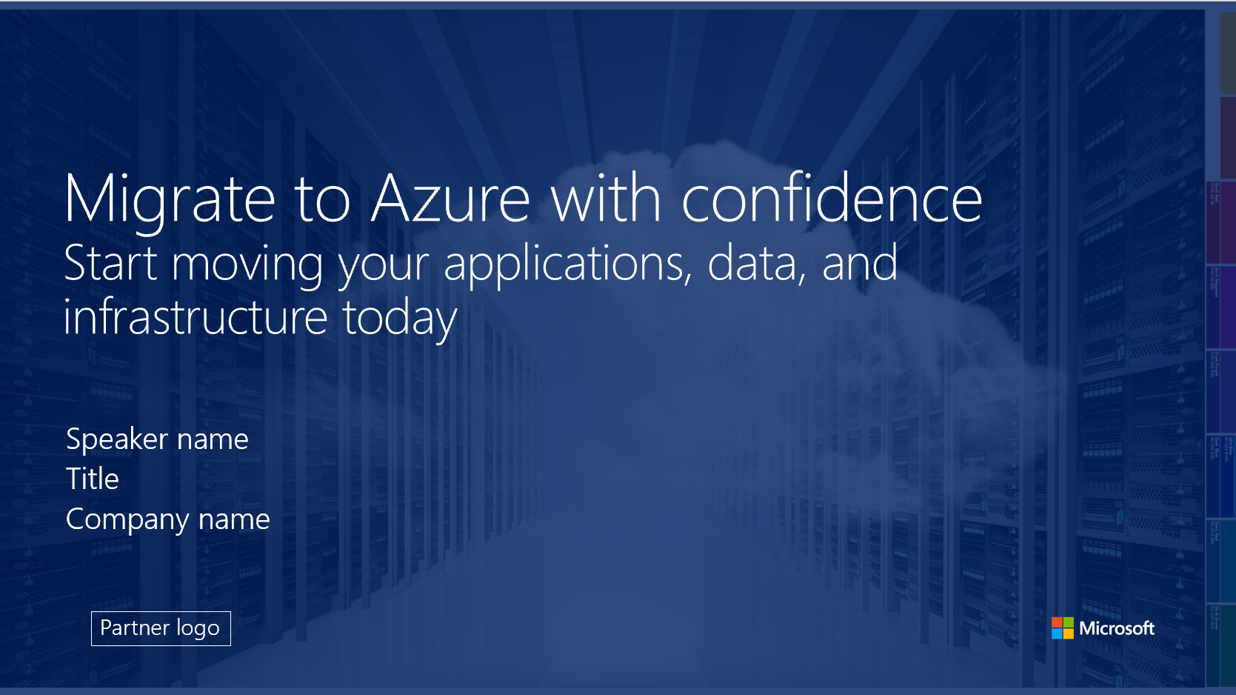
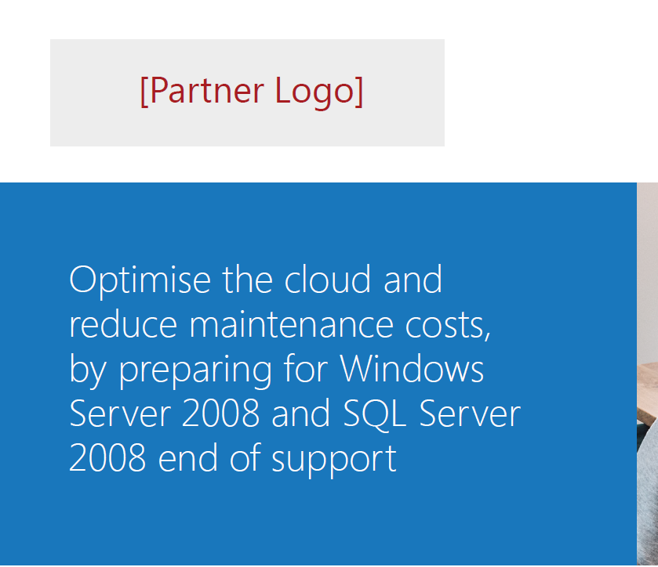
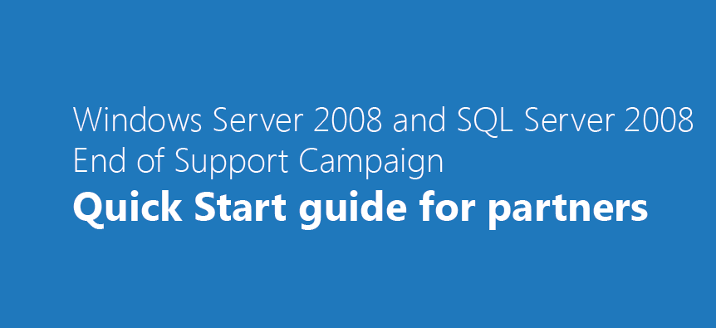
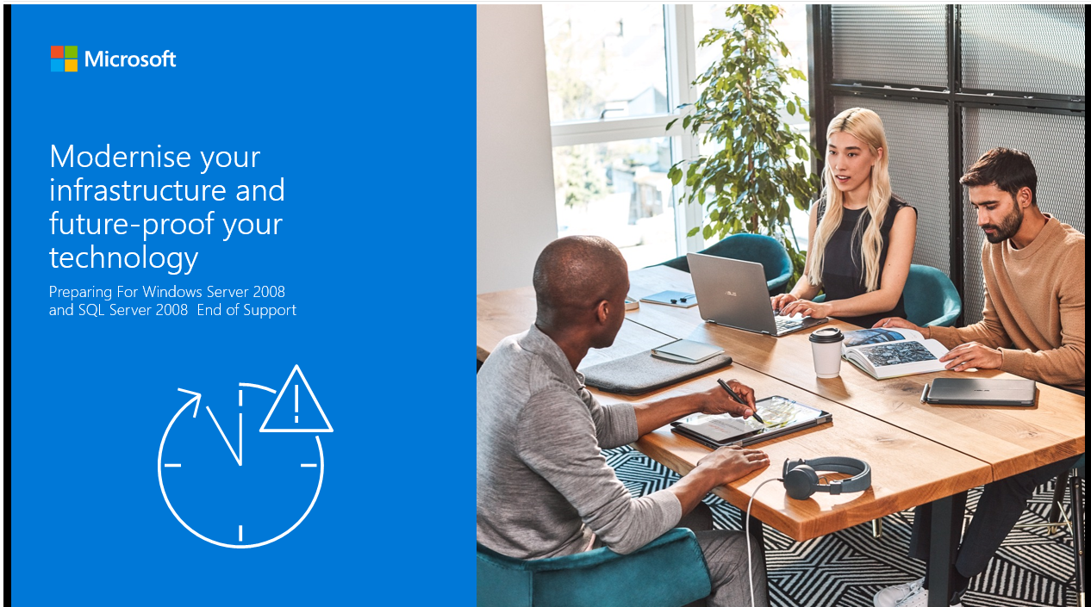
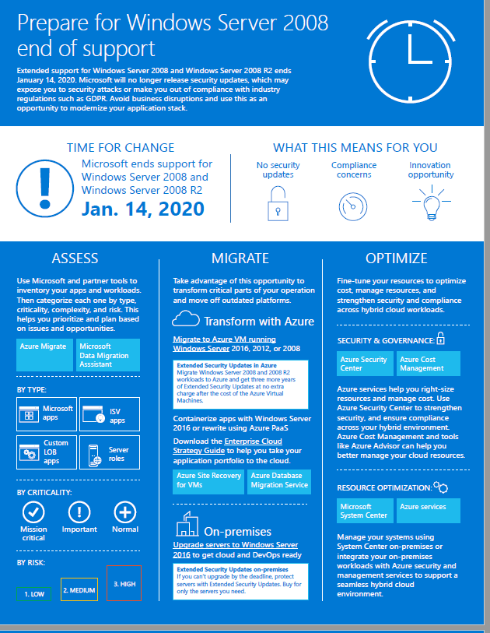
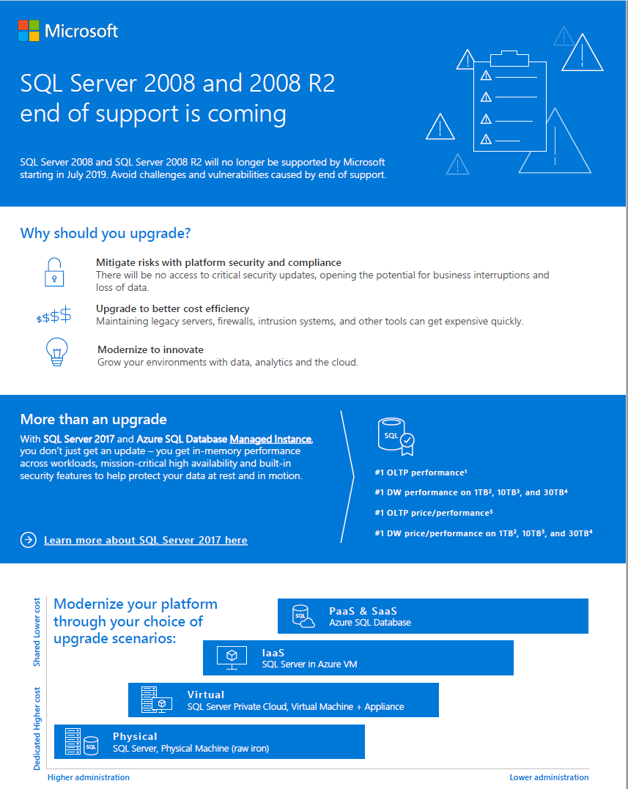
Windows Server on Azure - Partner Ready Assets
PLAY-IN-A-BOX NAVIGATION
Overview
Definitions
PiB Content Overview
Customer-Ready Assets
(Cloud Champion)
Solution Pitch Decks
The Essentials
Tele & Partner Marketing Assets (Cloud Champion)
Play-in-the-Box
Windows Server on Azure
1. Value Proposition
Page 1 of 3
Landing Page
Infographic
Copy Blocks
Customer email proposals
Customer Deck
Page 2 of 3
Page 3 of 3
2. Target Scenarios
3. Offers/Incentives/CTAs
4. Sales & Marketing Assets
5. Probing Questions
6. Enablement
The Ultimate Guide to Windows Server on Azure
Azure migration guide for Windows Server
SQLWindows Server 2008 EOS Infographis
Email templates
SQLWindows EoS Customer Deck (Cloud Champion)
Windows Server on Azure Solution Pitch Deck (Cloud Champion)
Windows Server on Azure Technical Customer Deck (Cloud Champion)
Windows Server EoS Customer Deck (Int’l) (Cloud Champion)
Azure Migration to Customer Presentation (MPN)
Migrating using Azure Migrate and Azure Site Recovery (MPN)
Sales Guide – Probing Questions
Partner FAQ
Next step 1
Next step 2
Next step 3
Check out the Cloud Champion portal to access and use this play and EOS assets.
Check out the MPN Data Center Transformation Sales Assets for additional sales tools
Check out the MPN Data Center Transformation Site for more resources

Slide 13
Top Probing Questions for Workload Migrations (1/2)
PLAY-IN-A-BOX NAVIGATION
Overview
Definitions
PiB Content Overview
Win Server to Azure IaaS:
Conversation starters will be upcoming expiring HW/SW/outsourcing contracts and SA renewals; opportunities for migrating OSS workloads may be uncovered as by-product of this conversation and will be covered in another play.
Play-in-the-Box
Windows Server on Azure
First Line of Questioning (EOS 2008 and 2008 R2)
Second Line of Questioning (Windows Server on Azure)
1. Value Proposition
Page 1 of 3
Page 2 of 3
Are you aware that Windows Server 2008 is reaching End of Support on 14 January 2020?
Have you identified what applications will be affected by the change?
Do you have critical applications running on Windows Server 2008 ?
Have you evaluated risks of staying the same?
What is your current plan of transition for this change?
Call to Action: Assessment
Have you done a workload level cloud migration assessment?
Do you manage your server infrastructure yourself or is it managed by someone else?
What challenges do you currently face in the maintenance and management of your datacentre and/or server environment?
Legacy Systems
Are you struggling to meet the needs of your business because of legacy silos and/or aging systems?
Is your physical server environment preventing you from satisfying your business needs?
Do you spend more time on “keeping the lights on” vs high ROI projects?
Are you working actively on cost optimization ?
Scale
Can your IT resources scale at the speed of your business processes?
Is your IT environment slow to scale up and down and quickly respond to the business needs?
Compliance
How do you mange security and compliance for your legacy applications and systems?
Hybrid
How important is interoperability between the cloud and your on-premise infrastructure?
Call to Action: Assessment
Have you done a workload level cloud migration assessment?
Page 3 of 3
2. Target Scenarios
3. Offers/Incentives/CTAs
4. Sales & Marketing Assets
5. Probing Questions
6. Enablement
Next step
Check out the Sales Guide for more details

Slide 14
Objection Handling (2/2)
PLAY-IN-A-BOX NAVIGATION
Overview
Definitions
PiB Content Overview
Objection/question | Suggested Response
“I’m hesitant to move to cloud IaaS because my business is beholden to several compliance mandates.” | Microsoft Azure has the most comprehensive list of compliance certifications of any hyper-scale cloud provider. Azure also has industry-leading capabilities to meet the needs of key compliance requirements. Please visit the Microsoft Trust Center to get a full list of Azure’s certifications and attestations.
“I don’t want to increase security risks by migrating to the public cloud.” | As a hyper-scale provider, Microsoft can make greater security investments than the majority of companies in the industry. By incorporating automation and machine learning capabilities into the core, Azure is continuously improving its ability to detect, isolate, and remediate potential threats. Moreover, Microsoft adheres to strict industry standards for security and is constantly tested and audited by 3rd party entities. Learn more at the Azure SecurityCenter.
“I don’t want to lose control of my company’s sensitive corporate and application data by moving to the cloud.” | With Azure, you have ownership of your data—that is, all data, including text, sound, video, or image files and software, that are provided to Microsoft by you, or on your behalf, through the use of Azure. You can access your data at any time and for any reason without assistance from Microsoft. Microsoft does not use customer data or derive information from it for advertising or datamining.
“I’m worried about the cost of transitioning to a new service delivery model. Won’t these new investments increase my overall operating costs?” | I could be quite the opposite. With the flexibility of cloud, you can spin up the resources you need instantly, scaling up and down based on demand and traffic. You only pay for what you use. With on-premises infrastructures, you may be stuck with under-utilized resources that require ongoing maintenance and capital investment to maintain. And , for stable workloads there is a great offer called Reserved Instances which is priced much lower than pay as you go.
“Why can’t I just buy Azure infrastructure services directly and deploy it myself?” | That is definitely a viable option, but consider the fact that thousands of customers hav used the Microsoft migration framework to migrate to the cloud and as your partner we do this as a repeatable process. Additionally, once your workload is in the cloud, your must continually maintain it to ensure it’s performing optimally. As a Service Provider we are here to offload the burden of maintaining your cloud infrastructure so you can focus on your strategic initiatives and the things that actually add value to your business.
“I am hesitant to get locked into an Azure commitment long term, do I have options here?” | One of the excellent benefits of Azure and the Microsoft Cloud Solution Provider (CSP) program is that you only pay for what you use If you want to try Azure out for a while, you can. It’s a true pay-as-you-go model and does not require a large upfront payment or multi-year contract.
Play-in-the-Box
Windows Server on Azure
1. Value Proposition
Page 1 of 3
Page 2 of 3
Page 3 of 3
2. Target Scenarios
3. Offers/Incentives/CTAs
4. Sales & Marketing Assets
5. Probing Questions
6. Enablement

Slide 15
Apps & Infra: Sales Play Enablement 1/2 Windows Server on Azure – Enablement Journey Summary
PLAY-IN-A-BOX NAVIGATION
Overview
Definitions
PiB Content Overview
This Play
Play-in-the-Box
Windows Server on Azure
1. Value Proposition
 | Security & Management | Windows Server on Azure | Business Continuity and Disaster Recovery
Start | Security Center | Windows Server VM SQL Server VM | Backup
Grow | + Log Analytics | <- Cross/Up Sell -> + SQL Managed Instance | + Site Recovery
Optimize | + 3:d party solutions | <- Cross/Up Sell -> + Containerization | + 3:d party solutions
Page 1 of 3
Page 2 of 3
Page 3 of 3
2. Target Scenarios
3. Offers/Incentives/CTAs
4. Sales & Marketing Assets
5. Probing Questions
6. Enablement

Slide 16
Apps & Infra: Sales Play Enablement 2/2 Windows Server on Azure – The Essentials
PLAY-IN-A-BOX NAVIGATION
Overview
Definitions
PiB Content Overview
Play-in-the-Box
 | Ready yourself for the customer conversation | Target & activate your sales | Become a better technical expert
Start | Learn about basic concepts from the deck “Journey to the cloud” Take the Azure Sales Fundamentals Training Learn the deck “How to pitch Azure to SMB Customers” Check out the Azure Migration Center online | Learn and use the WS 2008 EOS Deck Leverage the EOS infographic in your customer/partner conversations Leverage marketing assets such as emails and infographic in your customer/partner conversations | Take the learning path for Azure Apps and Infra: Cloud infrastructure and management (Cloud Champion) Take Adopting CSP: Technical Scenarios and Management Learn the migration process leveraging the migration guide and Azure Migration Center Get an overview of the migration tools available, select and go deep on the most applicable tools for you Get trained on Azure fundamentals on Microsoft Learn
Grow | Read the Cloud Migration and Modernization Playbook (MPN) Get yourself familiar with the Azure migration in-a-box readiness kit Learn how to create an account and set up a VM using Pitch Perfect (Cloud Champion) Check out the Reserved Instances resources on MPN an learn about RI for both Windows server and databases here | Learn and use the Ultimate Guide to Windows Server on Azure Learn and use the Windows Server on Azure Solution Deck Leverage SQL EOS brochure in your customer/partner conversations Leverage marketing assets such as emails and infographic to scale your outreach | Take training in SQL Managed Instances, Cosmos DB and Azure database for PostgreSQL / MySQL (Cloud Champion) Choose and take applicable training for Azure PaaS infrastructure services. Find technologies in the decks below. Learn and use the Ultimate Guide to Windows Server on Azure Learn and use the Windows Server on Azure Technical Deck excl Application Modernization Learn and use the Migration Deck excl Refactor / Rearchitect / Rebuild
Optimize | Read the Cloud Migration and Modernization Playbook (MPN) Check out the container resources available at MPN Get acquainted with the other Azure Solution plays such as Application Modernization, BCDR, Security & Management and Linux on Azure. | Learn and use (for your customer) applicable parts of the Azure value prop, the migration value prop and the migration strategies in the Migration deck Drive upsell and cross-sell leveraging additional Azure Solution Plays | Take Technical deep dive on migrating application to Azure - Application Modernization (Cloud Champion) Choose and take applicable training for containerization and other applicable Azure PaaS application modernization services. Find technologies in the decks below (Cloud Champion / MS Learn) Learn/Use the Windows Server on Azure Technical Deck incl Application Modernization Learn/Use the Migration Deck incl. Refactor / Rearchitect / Rebuild Learn the technical aspects of additional Azure Sales Plays
Windows Server on Azure
1. Value Proposition
Page 1 of 3
Page 2 of 3
Page 3 of 3
2. Target Scenarios
3. Offers/Incentives/CTAs
4. Sales & Marketing Assets
5. Probing Questions
6. Enablement
Next step
Next step
Next step
Check out Cloud Champion EOS assets and the MPN Data Center Transformation site for more
Check out Pitch Perfect on Cloud Champion and the MPN Data Center Transformation Sales Assets
Check out the learning paths at Microsoft Learn for more training, certification and hands-on labs.

